Slide 1


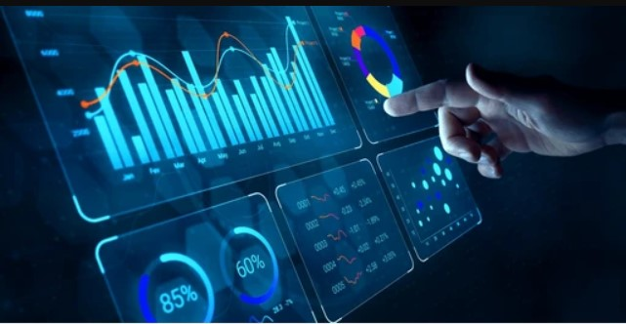
Prepared by: 1-Omar Mohamed Saeed 2-Michael Morris Atta 3-Ahmed yousef Mohamed Supervised by : Eng. Ahmed Samir
HR Data Analysis

Slide 2

Introduction
In this HR analytics project, we worked with two distinct datasets simulating real-world HR systems.
The Employee Table (1,470 rows, 24 columns) covers demographic and job-related data such as department, job role, salary, gender, education, and attrition status.
The Performance Table (6,709 rows, 15 columns) contains performance metrics like job satisfaction, environment satisfaction, training frequency, manager evaluations, and work-life balance.
Our goal is to analyze employee distribution, performance and satisfaction levels, attrition trends, and salary analysis using tools like Excel, SQL, Python, and Power BI, and to deliver actionable insights through visual dashboards.

Slide 3
Tasks
1-HR Analysis
2-Presentation
3-Documentation

Slide 4
Contents
1-Data Preparation
2-Analysis Questions
3-Dashboard

Slide 5
Data Loading & Exploration and Cleaning
1-Data Preparation

Slide 6
Data Loading & Exploration and Cleaning
Load Data
Employee Table : 1,470 rows, 24 columns
Performance Table : 6,709 rows, 15 columns
Data preparation
Missing values ,NULLS and Duplication
Python used tools

Slide 7
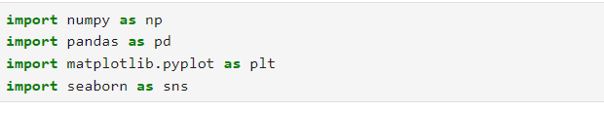
Import Libraries
Import essential libraries for:-
Data processing
Data cleaning
Data visualization
Forecasting

Slide 8
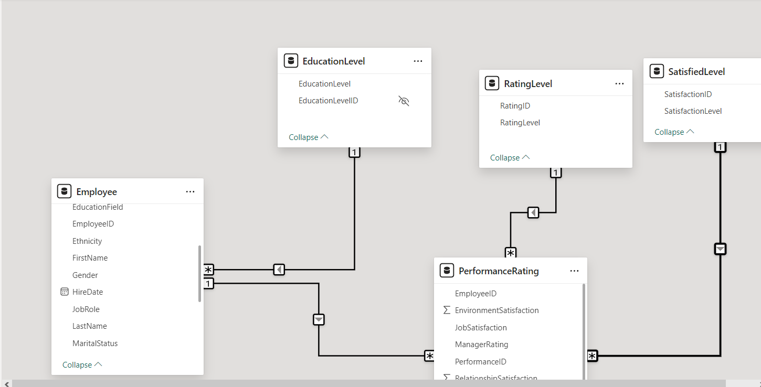
Data Modeling
The original data consisted of several separate tables: Employee, Education Level, Rating Level, Satisfied Level, and Performance Rating
After data modeling and integration, the information was consolidated into two main tables
Employee Table :containing core employee information.
Performance Rating Table: containing performance evaluations and satisfaction levels.
This process helped simplify the analysis and improve the quality of the insights.

Slide 9
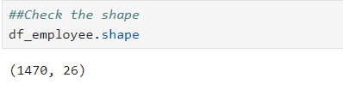
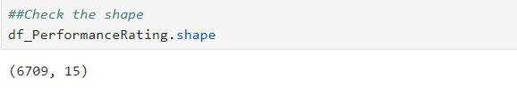
Data Exploration
1470 Rows * 26 Columns
6709 Rows * 15 Columns

Slide 10
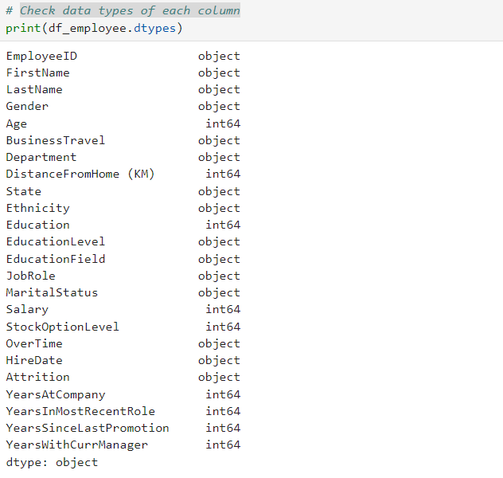
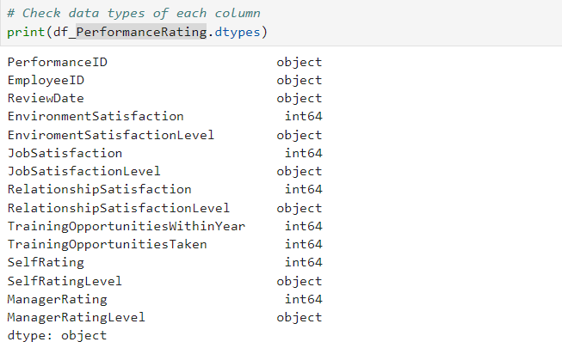
Data Exploration

Slide 11
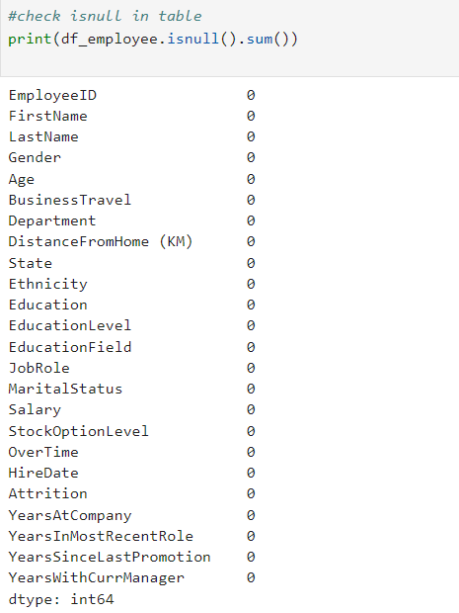
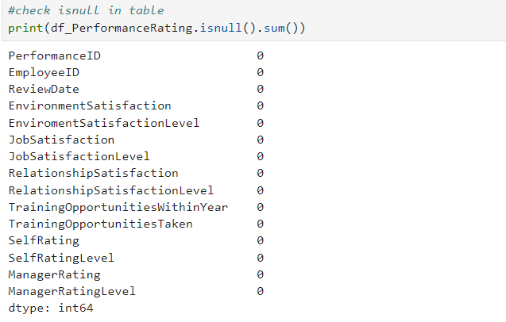
Data Preparation

Slide 12
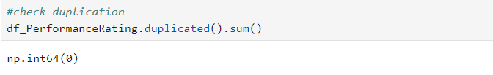
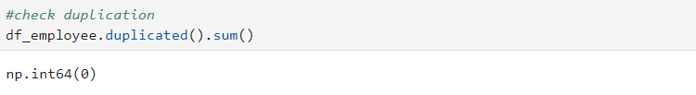
Data Preparation

Slide 13
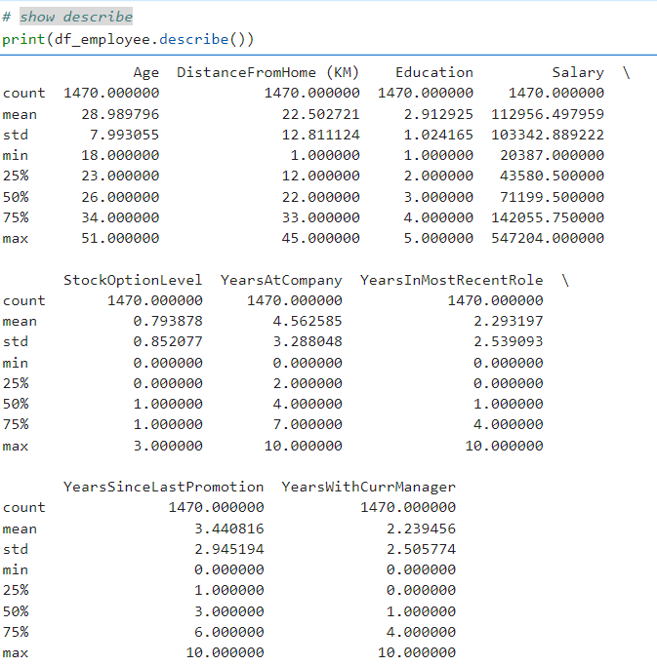
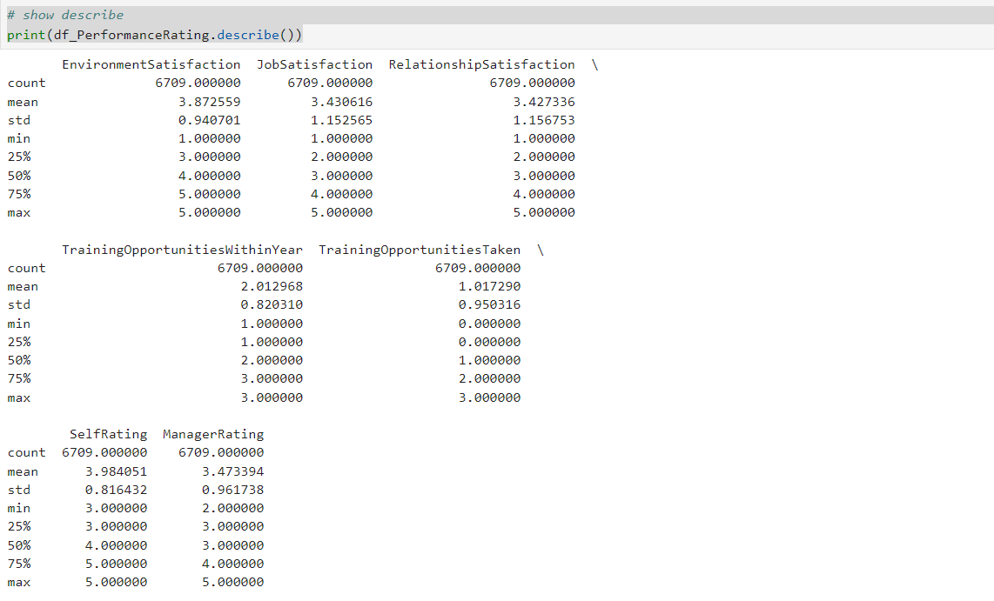
Data Cleaning

Slide 14

🧩 Employee Distribution & Demographics Analysis
What is the distribution of employees across departments and job roles?
How is gender and age distribution across different departments?
Which education levels and fields are most common?

Slide 15
🚪 Attrition & Retention Analysis
What is the overall attrition rate?
Which departments or job roles have the highest attrition?
Does overtime, salary, or distance from home influence attrition?

Slide 16

💰 Salary Analysis
What is the average salary across all employees?
How does the average salary vary by department?
Are there any salary differences between male and female employees?
What are the highest and lowest paying job roles in the company?
Does age have a correlation with salary levels?
What is the salary distribution by education level?
How does salary vary across different U.S. states?
Is there a pattern in salary based on hire year (e.g., do more experienced employees earn more)?
What percentage of employees fall under each salary level category (e.g., Low, Medium, High)?
How does salary relate to attrition (e.g., do lower-paid employees leave more frequently)?

Slide 17

🌟 Performance & Evaluation Analysis
How does average performance vary by department?
What is the performance distribution across different age groups?
Do employees with higher education levels tend to have better performance scores?
Which job roles have the highest and lowest average performance ratings?
Is there a relationship between performance level and attrition?

Slide 18
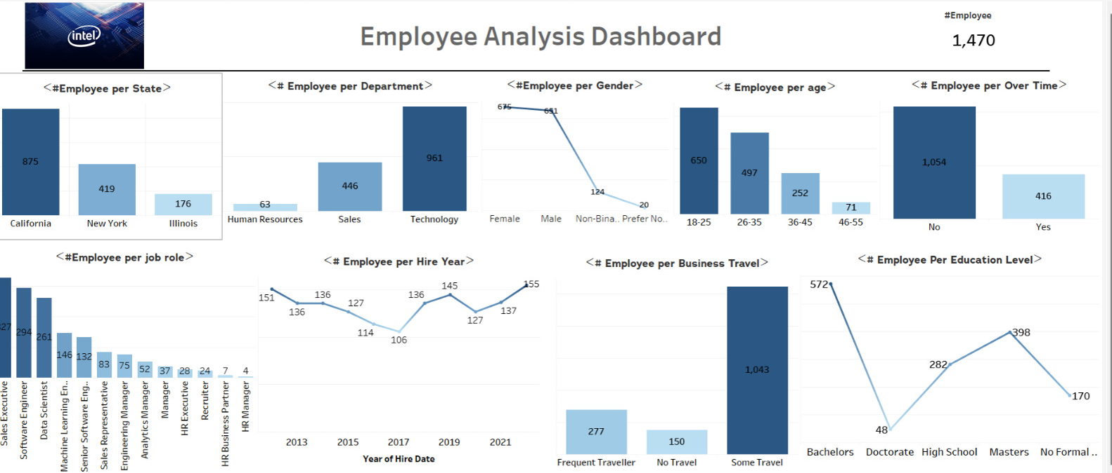

Slide 19
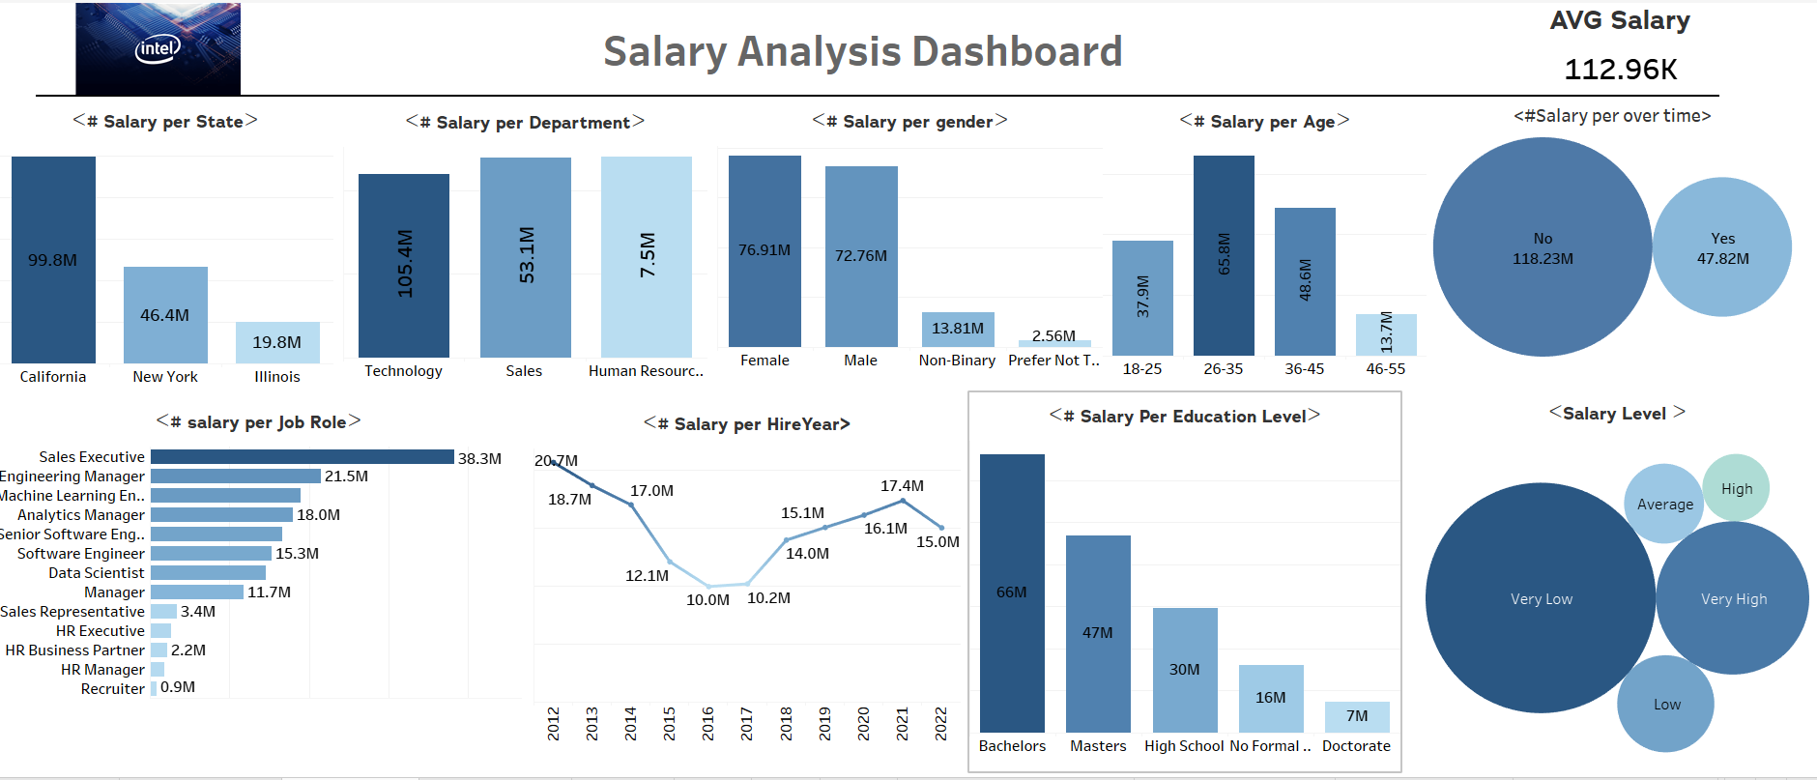

Slide 20
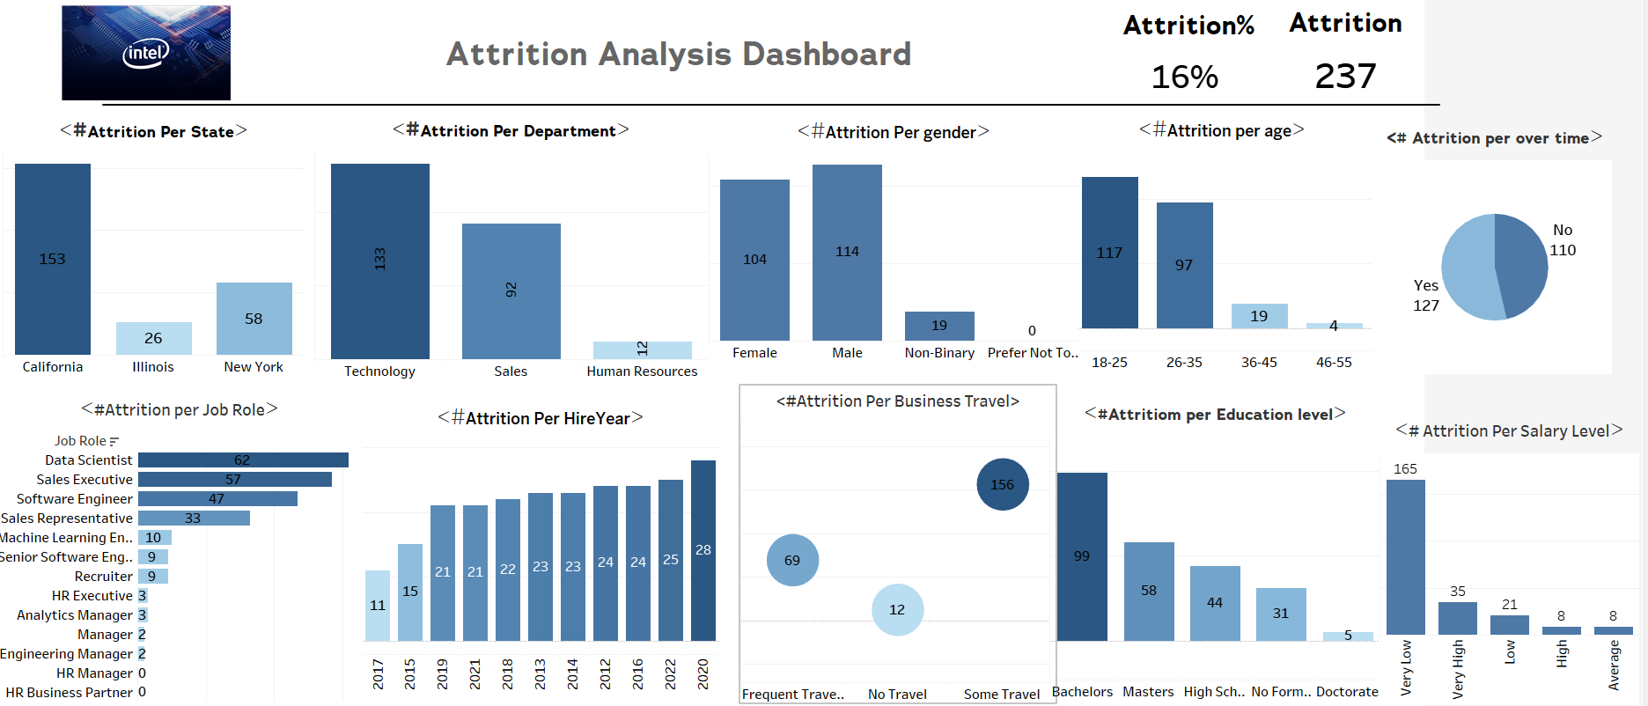
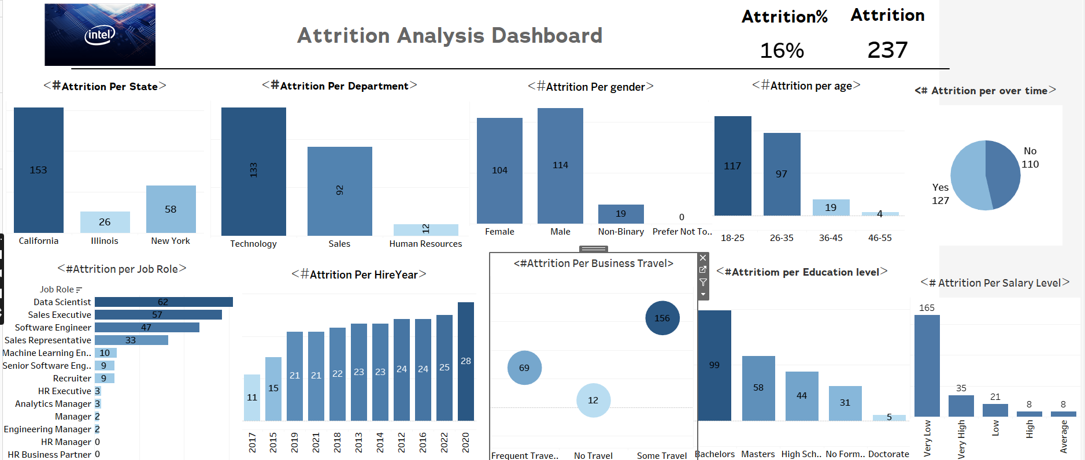

Slide 21
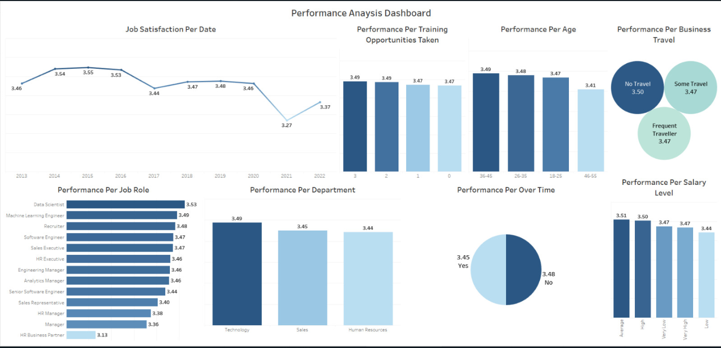

Slide 22
Recommendations
💸 Review compensation strategy to reduce salary disparities.
📈 Introduce incremental salary progression plans to motivate retention.
👂 Conduct exit interviews for low-salary leavers to understand drivers.
🎓 Offer career growth paths and training to justify salary increases.

Slide 23
Recommendations
Improve Work Environment
Strengthen HR Resources
Enhance Employee Well-being
Boost Recognition and Rewards
Optimize Travel and Remote Work

Slide 24
Thank you

